Slide 1
Reading Asia welcoming award-winning children’s literature into your classrooms.
Luciano Marzulli
K-16 Outreach Coordinator

Slide 2
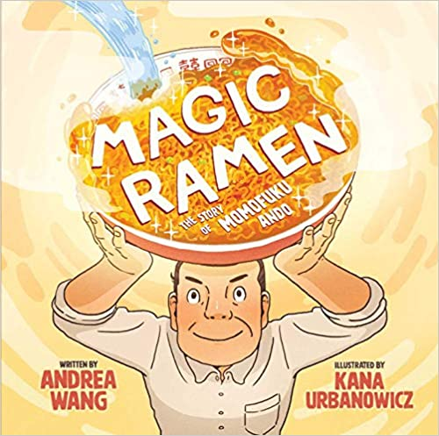
This session will provide an opportunity to take an in depth look at the 2019 Freeman Book Award Honorable Mention title: Magic Ramen: the story of Momofuku Ando written by Andrea Wang and illustrated by Kana Urbanowicz.
Notes:
My intro-who am I and what do I do
Who is in the room?
Poll in zoom:
Do you eat Ramen? If yes, how do you like to eat Ramen? What's your favorite flavor or topping? Where do you like to get Ramen?

Slide 3
Freeman Book Awards
Honoring East And Southeast Asian Titles for Children and Young Adults
The National Consortium for Teaching about Asia (NCTA), the Committee on Teaching about Asia (CTA) of the Association for Asian Studies (AAS), and Asia for Educators (AFE) at Columbia University sponsor the annual Freeman Book Awards for new young adult and children’s literature. The awards recognize quality books for children and young adults that contribute meaningfully to an understanding of East and Southeast Asia. Awards are given in two categories: Children’s and Young Adult on the several countries of East and Southeast Asia.

Slide 4
Magic Ramen: the story of Momofuku Ando
By Andrea Wang
Illustrated by Kana Urbanowicz
Notes:
Inspiration struck when Momofuku Ando spotted the long lines for a simple bowl of ramen following World War II. Magic Ramen tells the true story behind the creation of one of the world’s most popular foods.
Every day, Momofuku Ando would retire to his lab—a little shed in his backyard. For years, he’d dreamed about making a new kind of ramen noodle soup that was quick, convenient, and tasty for the hungry people he’d seen in line for a bowl on the black market following World War II. Peace follows from a full stomach, he believed.
Day after day, Ando experimented. Night after night, he failed. But Ando kept experimenting.
With persistence, creativity, and a little inspiration, Momofuku Ando succeeded. This is the true story behind one of the world’s most popular foods.

Slide 5
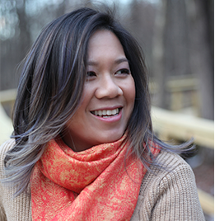
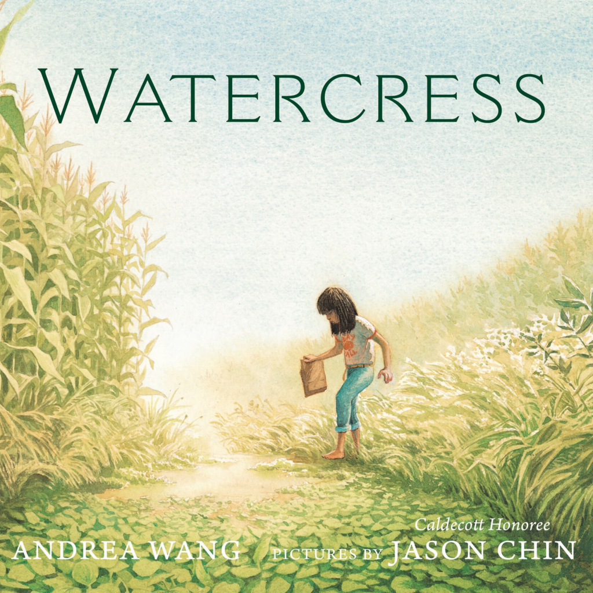
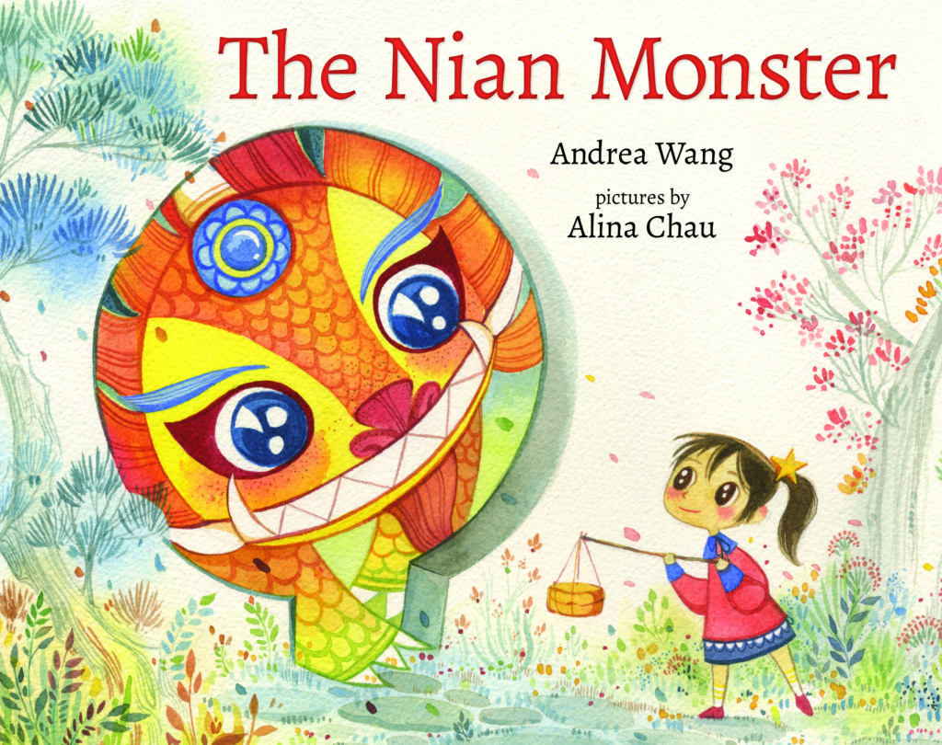
Andrea Wang
Andrea Wang loves noodles, food, and noodling about food. A former environmental scientist, Andrea is the author of Magic Ramen: The Story of Momofuku Ando. Andrea lives in Colorado with her family and their dog, Mochi. Sometimes they have instant ramen for breakfast. You can find out more about Andrea at andreaywang.com.
Notes:
Andrea Wang loves noodles, food, and noodling about food. A former environmental scientist, Andrea is the author of Magic Ramen: The Story of Momofuku Ando. Andrea lives in Colorado with her family and their dog, Mochi. Sometimes they have instant ramen for breakfast. You can find out more about Andrea at andreaywang.com.

Slide 6
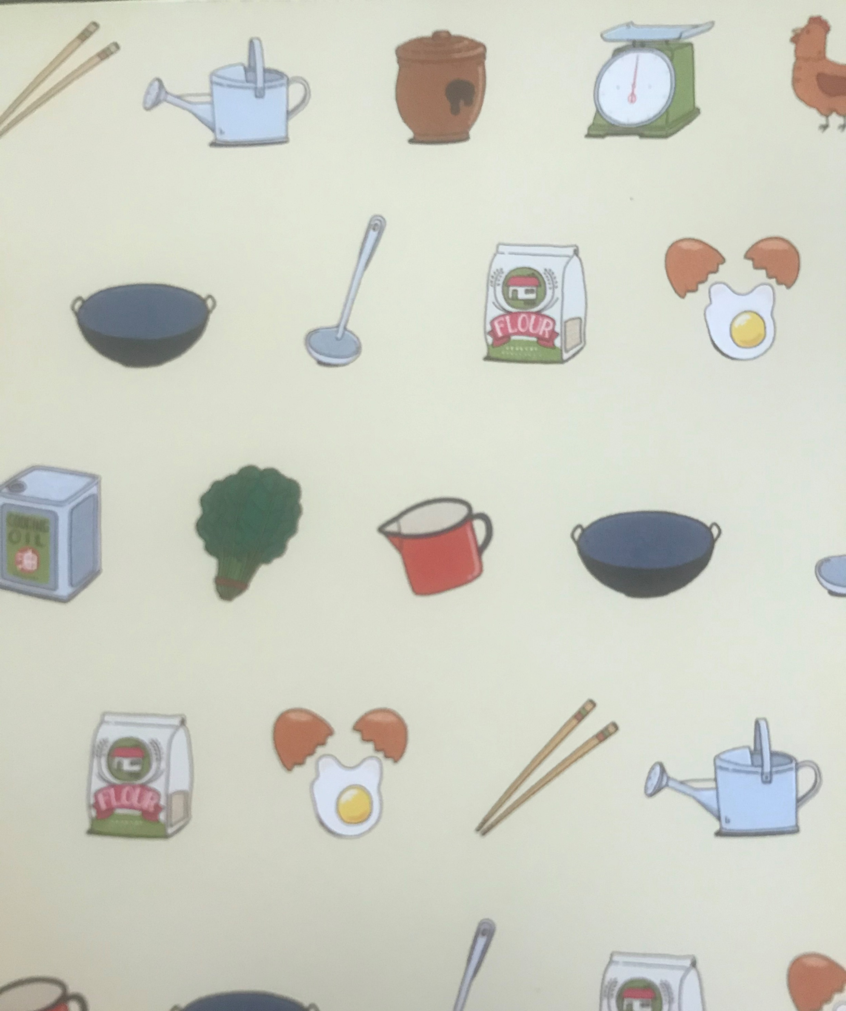
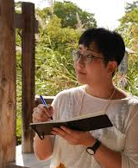
Kana Urbanowicz
Illustrator
Kana Urbanowicz is a Japanese designer creating unique illustrations, animations, comics, and other digital and hand painted works. In 2005, she graduated from Japan Electronics College. After her studies, she specialized in web design and started work as a full-time illustrator at a design company. While working there, she continued making original character designs and figurines. In 2017 she turned to a freelance career.
Notes:
Kana Urbanowicz is a Japanese designer creating unique
illustrations, animations, comics, and other digital and hand
painted works. In 2005, she graduated from Japan
Electronics College. After her studies, she specialized in web
design and started work as a full-time illustrator at a design
company. While working there, she continued making
original character designs and figurines. In 2017 she turned
to a freelance career.

Slide 7
Let’s Read!
Reading of the title with the Author Andrea Wang: https://www.youtube.com/watch?v=DniXZhjwS8I
Notes:
Reading of the title with the Author Andrea Wang: https://www.youtube.com/watch?v=DniXZhjwS8I

Slide 8
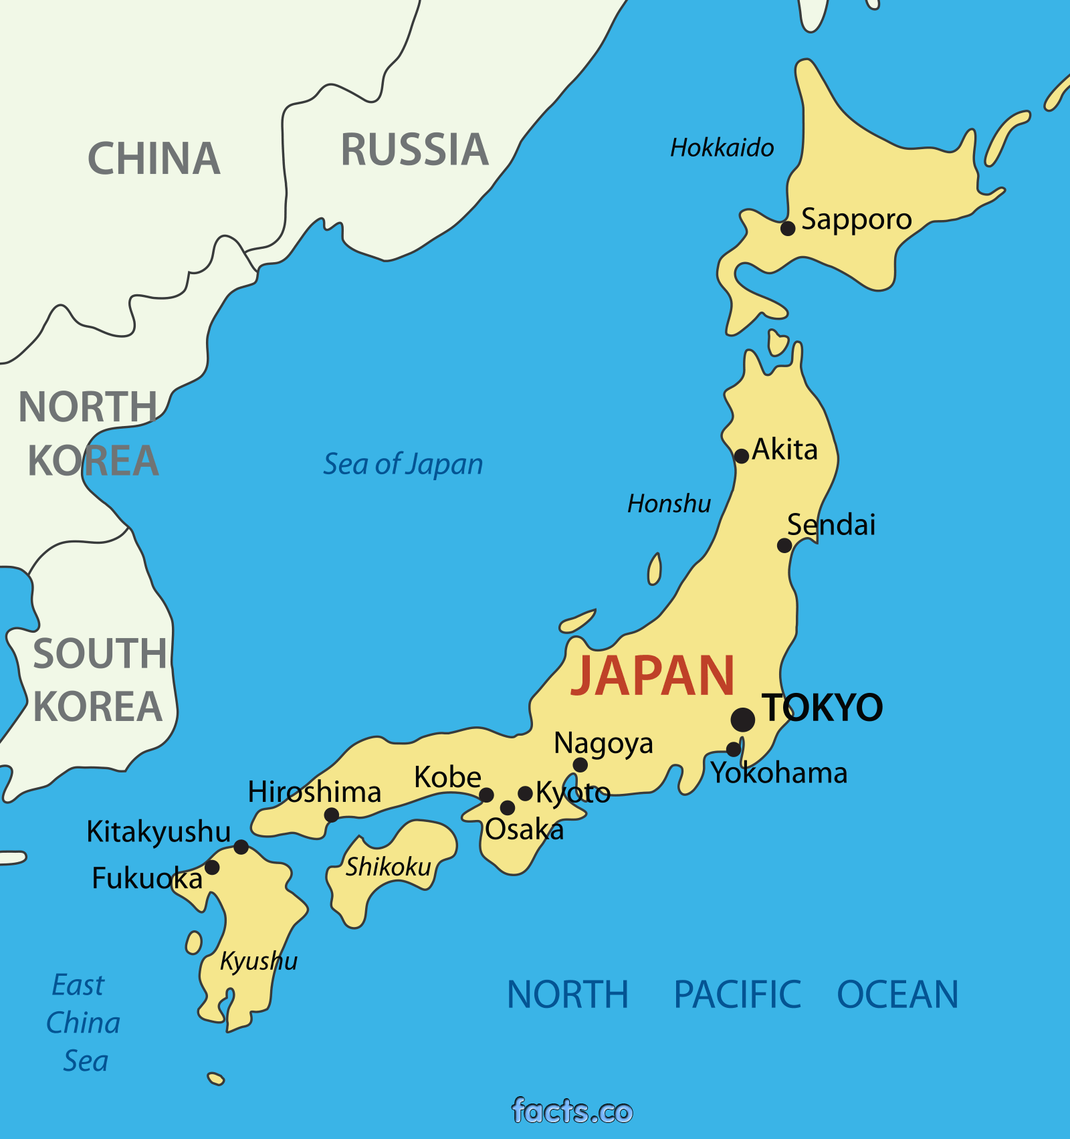
Japan in Context
Pre-War Japan
Recovering from economic depression (like the U.S.)
At war with China since 1937
Politics increasingly dominated by the military
Ideological shift: Shintoism dominating Buddhism
Racism from the West
There’s a great onesheet synopsis with more details from the East Asian Institute at Columbia University’s Asia For Educators linked here:
http://afe.easia.columbia.edu/special/japan_1900_power.htm

Slide 9
Japan in Context
Pre-War Japan
In addition, Britannica offers a three minute video, from a Western lens, about the context of Japan engaging in World War II.
https://www.britannica.com/video/72837/leaders-Tripartite-Pact-Imperial-Japan-conflict-Nazi-December-1941

Slide 10
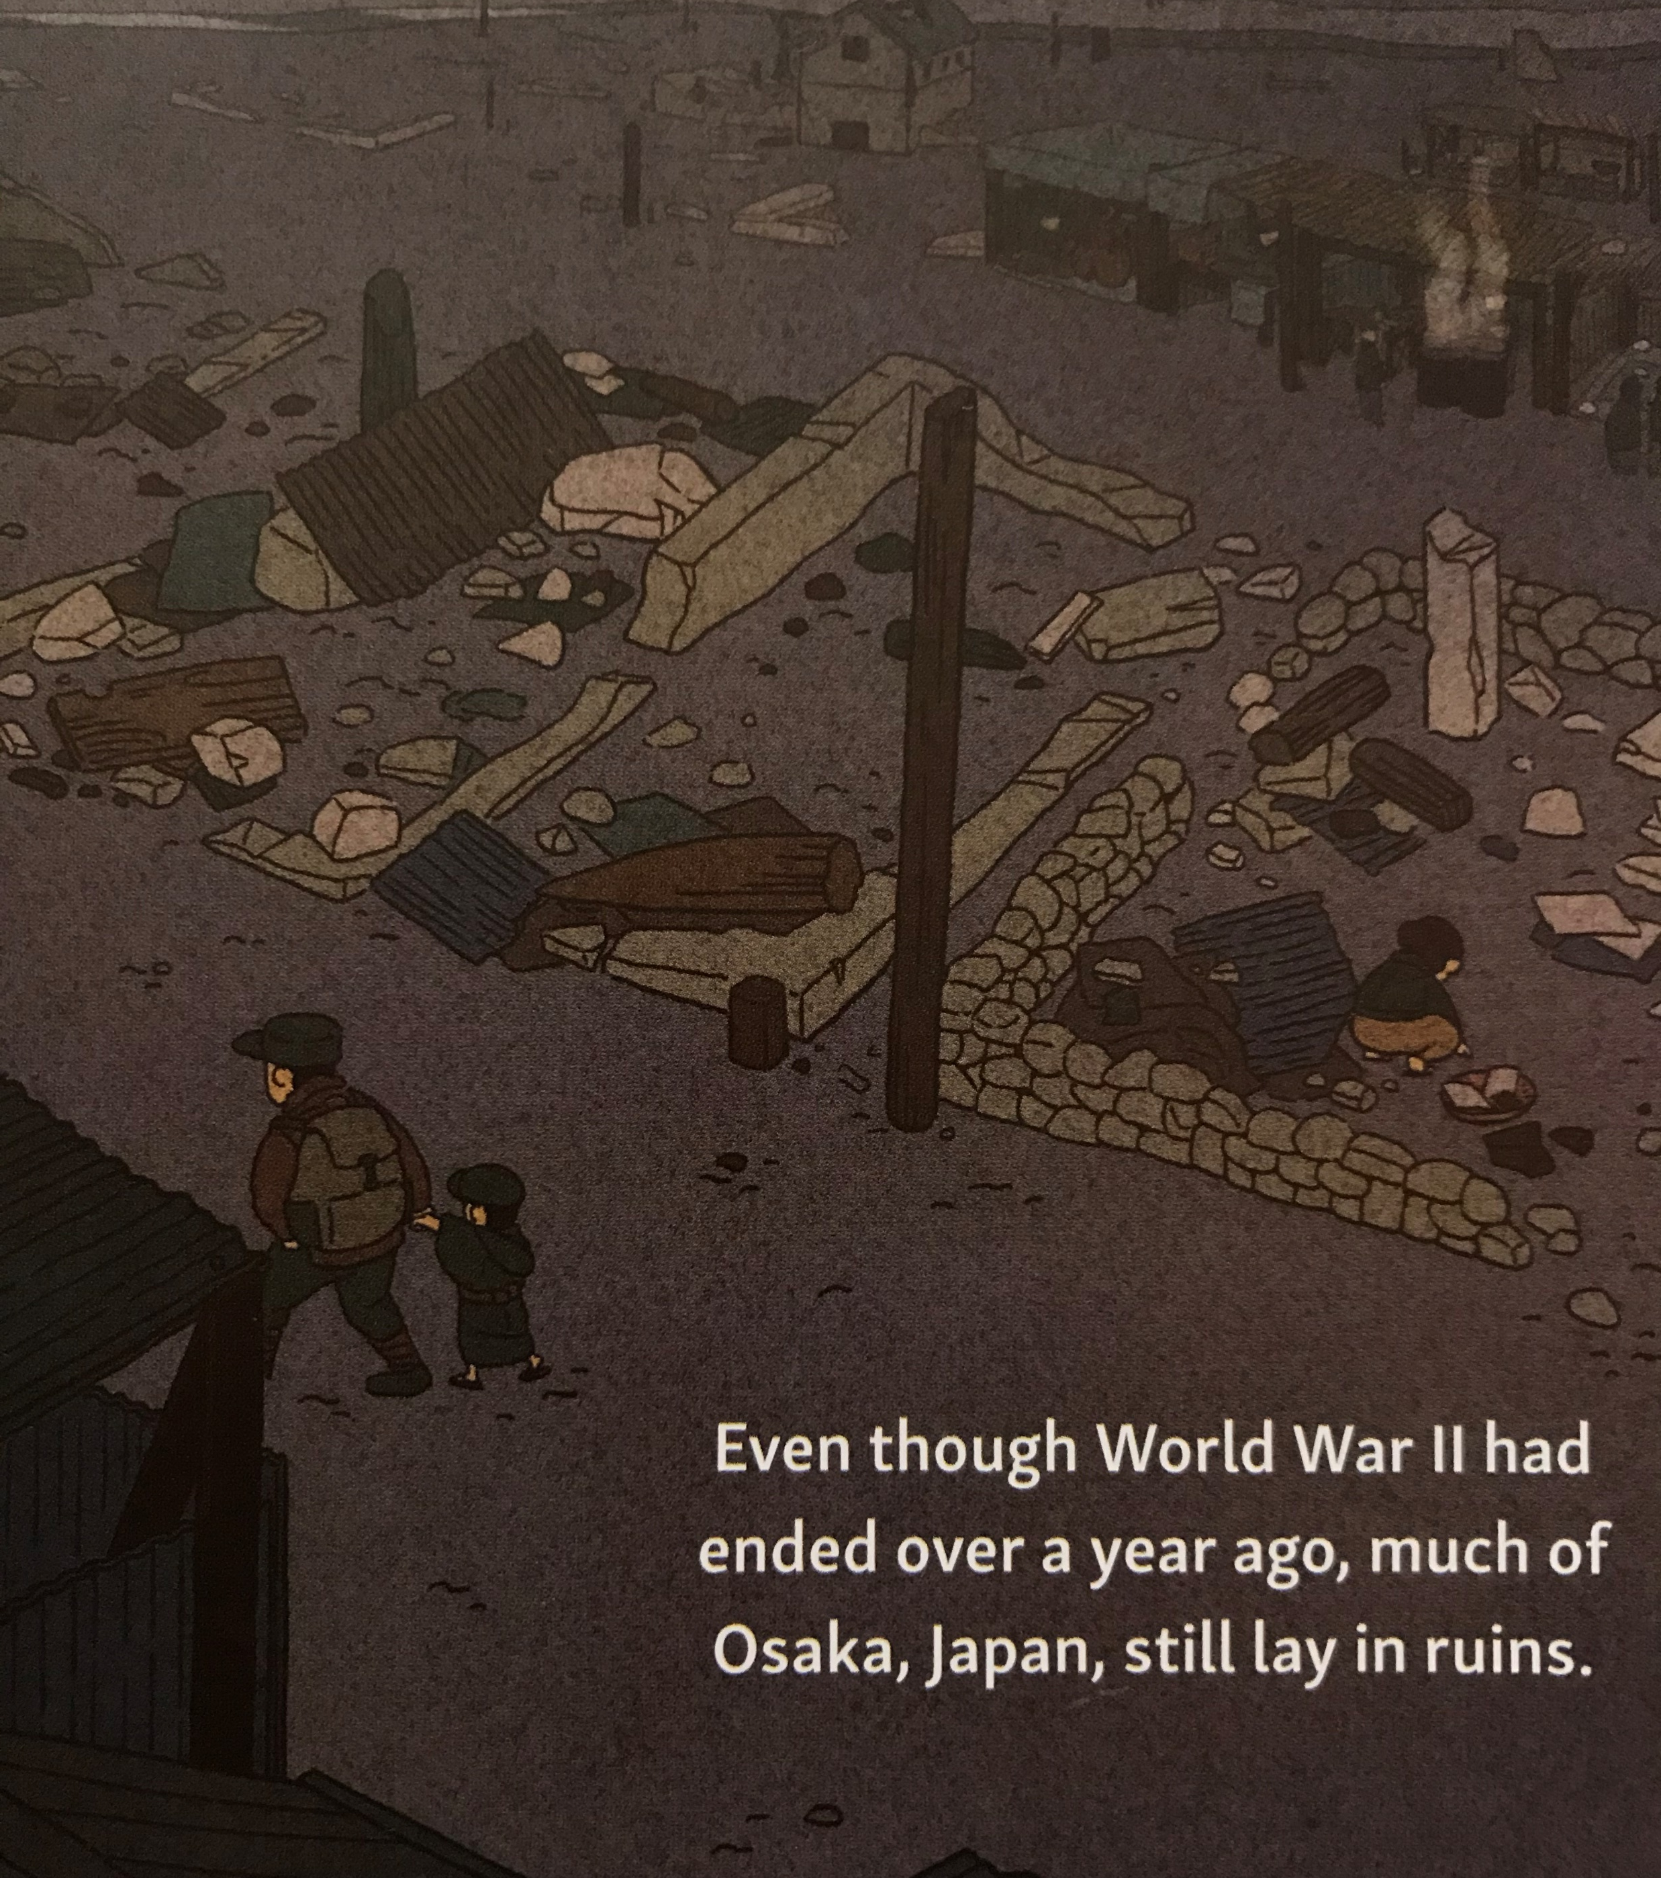
Japan after WWII
Allied Occupation (1945-1952)
Lesson plan: https://aboutjapan.japansociety.org/content.cfm/the_occupation_of_japan_and_democratic_reform
Post War Japan (1952-)
https://aboutjapan.japansociety.org/content.cfm/postwar_japan_1952-1989

Slide 11
Comic Style elements of the illustrations

Slide 12
Comic Style elements of the illustrations

Slide 13
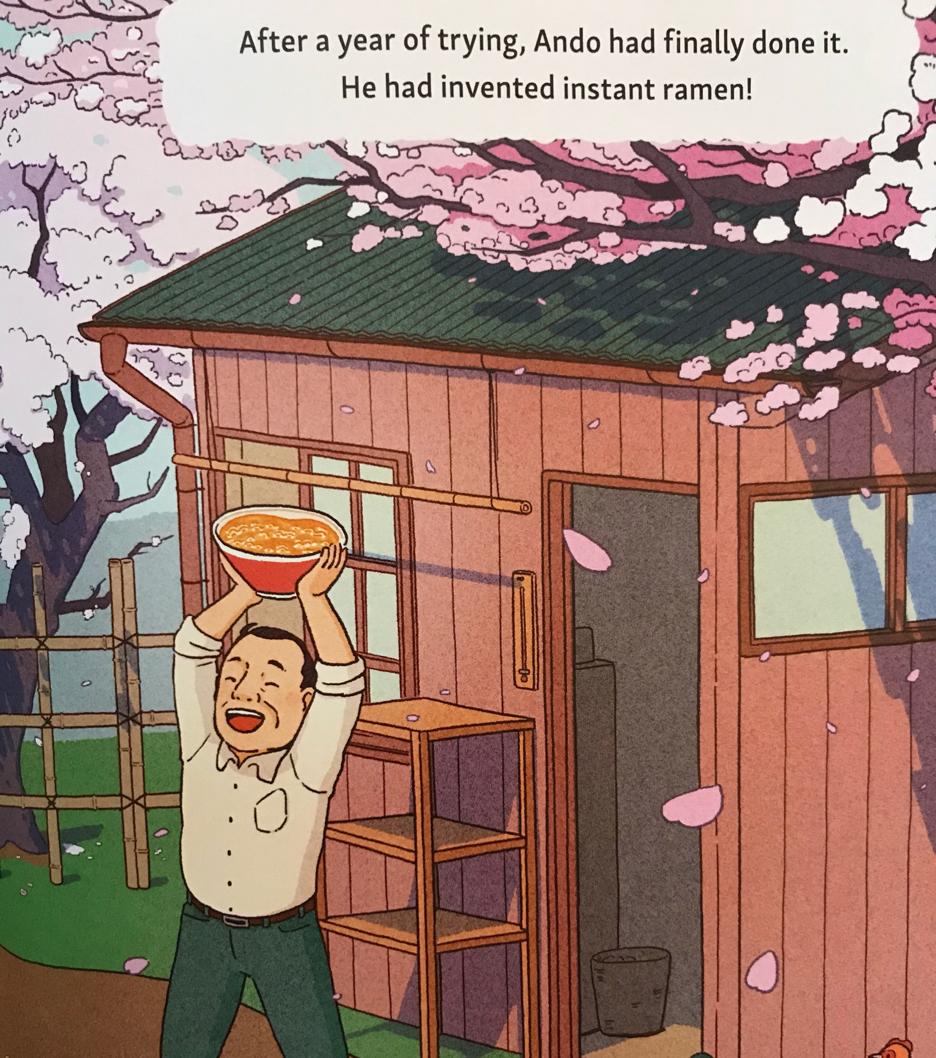
Additional Readings & resource links…
The messy History of Ramen: https://firstwefeast.com/eat/2014/05/george-solt-on-the-messy-history-of-ramen
The Untold History of Ramen https://www.ucpress.edu/book/9780520282353/the-untold-history-of-ramen
The history of the Ramen Noodle: https://www.newyorker.com/culture/culture-desk/the-history-of-the-ramen-noodle
Map of food origins: https://www.npr.org/sections/thesalt/2016/06/13/481586649/a-map-of-where-your-food-originated-may-surprise-you

Slide 14
Freeman Book Awards Resources
http://nctasia.org/resources/

Slide 15
READ U
Curated book sets through the College of Education:
http://readu.utah.edu

Slide 16
Let’s work together!
Luciano Marzulli
l.marzulli@utah.edu
K-16 Outreach Coordinator
International and Area Studies
801.581.6518
http://ias.utah.edu
Notes:
List servs
In services with districts or schools

